Slide 1
Dyadic Behavioral Asymmetry and Linguistic Alignment: an Effort-Reward Perspective
or:
The Down Bad Index and Other Fun Things
feat. fish from Baltimore Aquarium
shawn wang
shawnwang@temple.edu
github.com/fsleyes

Slide 2
Introduction
Social motivation is closely tied to a number of mental health outcomes, specifically within the field of mood disorders (Alloy et al., 2016)
In unipolar depression, anhedonia is a core symptom and is strongly linked to reduced motivation to pursue rewarding activities, such as social interactions (Gandhi et al., 2022)
In contrast, hypomanic and manic episodes in bipolar spectrum disorders (BSDs) feature increased talkativeness or pressured speech as a symptom (Crocamo et al., 2025; Nusslock et al., 2025).

Slide 3
Introduction
Within this framework, tasks such as the Effort Expenditure for Rewards Task attempt to provide an objective behavioral measure of reward motivation, showing that higher anhedonia predicts reduced reward motivation (Treadway et al., 2009).
Follow-up work links social anhedonia and depression symptoms to altered effort based decision making for monetary reward (McCarthy et al., 2015).
Similarly, evidence among those diagnosed with BSDs show heightened social reward anticipation in fMRI contexts (Alloy et al., 2016).
However, the role of social reward effort expenditure in individual with trait reward hypersensitivity is relatively less studied.

Slide 4
Introduction
Findings from studies examining conversations in dyads suggest that linguistic alignment between participants may reflect engagement with each other rather than simple rapport (Niederhoffer & Pennebaker, 2002)
This suggests that lexical alignment may represent a proxy of, or at least partially reflective of, effort that one party chooses to expend towards their conversational partner.
However, this hypothesis is yet untested, specifically within the domain of affective linguistic alignment (e.g. happiness, sadness, guilt, etc.).

Slide 5
Introduction
Furthermore, communicative effort in naturalistic texting may be treated as a domain-specific analog of effort-based decision making.
Individuals choose levels of effort to expend that are reflected through a number of behaviors (e.g. how often to initiate contact, how quickly to respond, how long messages should be, etc.) under uncertain social reward expectations.
This operationalization of effort expenditure for social reward is too, yet untested.

Slide 6
Research Question
I propose that the relationship between behavioral asymmetry and affective linguistic alignment is driven by motivated attention and effort expenditure.
Research Question:
Does the degree of dyadic linguistic alignment on affective dimensions by conversation predict dyadic behavioral asymmetry in that same conversation in a naturalistic text message corpus?

Slide 7
Hypothesis
Greater linguistic alignment within a dyad will be negatively associated with dyadic behavioral asymmetry. That is, dyads with higher alignment will show lower behavioral effort asymmetry (i.e. more equal effort across dyad), whereas dyads with lower alignment will show greater behavioral asymmetry (i.e. less equal effort across dyad).

Slide 8

Methods:
I hope you remember what the methods were from a few weeks ago!
dyadic behavioral asymmetry:
convo end ratio
convo start ratio
response time ratio
message ratio
word ratio

Slide 9
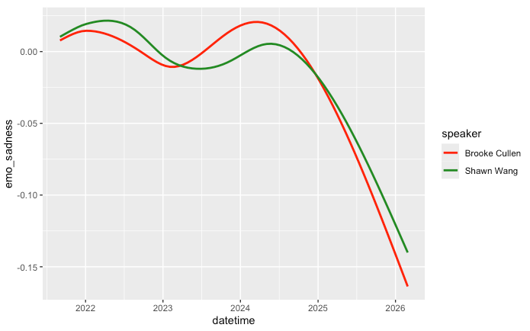
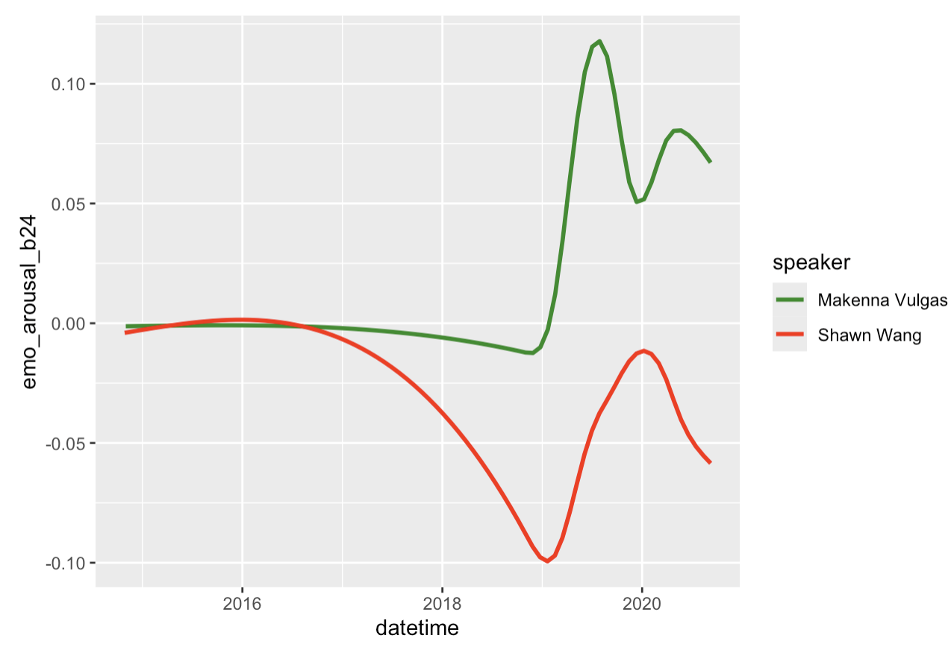
Methods:
high conversation alignment:
low conversation alignment:

Slide 10
Methods:
Five linguistic dimensions:
anxiety
arousal
happiness
intensity
sadness
AUC:
Immediate AUC
Lagged AUC
Lead AUC
Turn Corr:
Immediate turn corr.
Lagged turn corr.
Lead turn corr.

Slide 11

Methods:
Six alignment metrics:
Immediate AUC
Lag 1 AUC
Lead 2 AUC
Immediate turn corr.
Lag 1 turn corr.
Lead 2 turn corr.
LAG 1

Slide 12
Methods:
Six alignment metrics:
Immediate AUC
Lag 1 AUC
Lead 2 AUC
Immediate turn corr.
Lag 1 turn corr.
Lead 2 turn corr.
LEAD 2

Slide 13
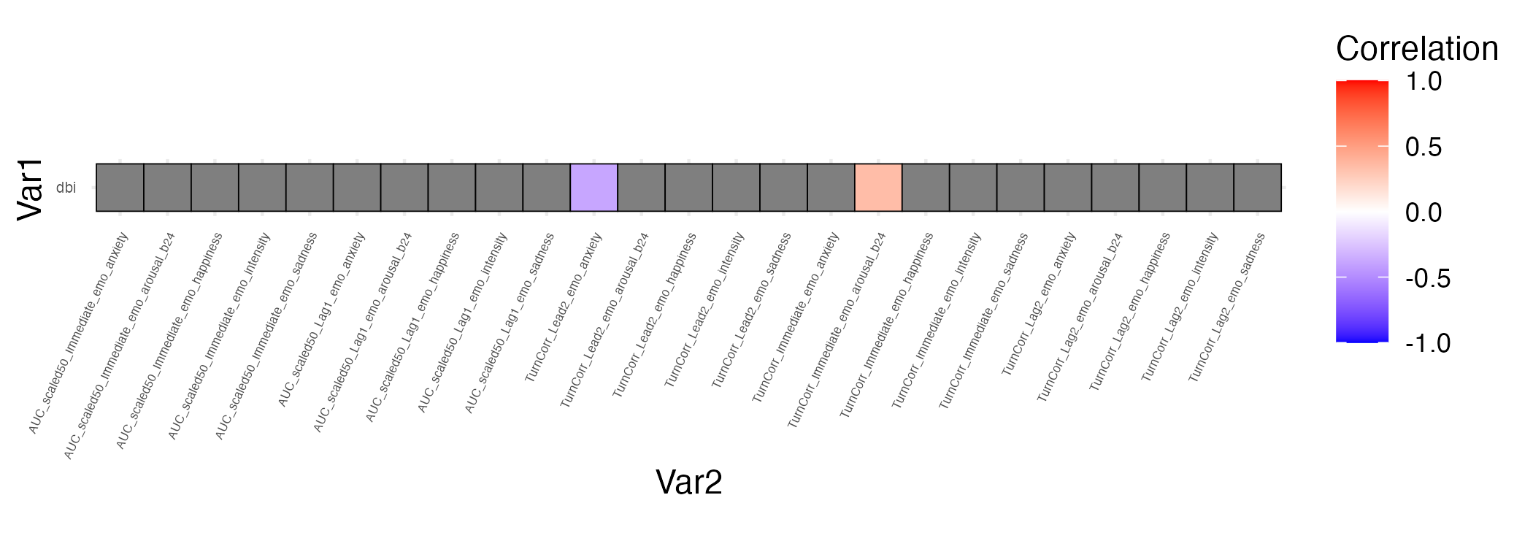
Results:
Corr. Lead 2 Anx
Corr. Immediate Arousal

Slide 14
Results:
Corr. Lead 2 Anx
Notes:
there is a significant and negative correlation between behavioral asymmetry and anxiety when leading 2 turns. let’s put this into context of what these actual values mean because it gets very abstract very quickly.
first, the dbi is a measure of behavioral asymmetry where POSITIVE values always means that the speaker (ie me) is putting in more effort than the other person
and this lead 2 correlation value is the relationship between THEIR anxiety value and MY anxiety value TWO TURNS LATER, meaning their linguistic anxiety is preceding my linguistic anxiety
putting that together, it means that the more effort i put into the conversation, the less their linguistic anxiety is pushing or moving my linguistic anxiety later. i am becoming less responsive to others’ emotional lead as conversational imbalance increases. maybe i’m too focused on the conversation going so i have less emotional bandwidth to pick up on their anxiety or that i am trying to be reassuring if i am picking up on that anxiety. the effort seems to be more directed towards maintaining the conversation rather than being more emotionally attuned.

Slide 15
Results:
Corr. Immediate Arousal
Notes:
now how about this other result? the higher effort that i’m putting into this conversation, the more correlated our messages are in terms of emotional arousal turn by turn with no delay.
for each exchange, if it is a conversation i am putting disproportionately more effort into, then they are more likely to match my emotional arousal in the immediate reply. on one hand this makes some sense that if i am the one driving the conversation, then they are reacting to my tone in the moment and following my lead.
however you may have also expected that a more disengaged partner would be less emotionally reactive, so this is somewhat counterintuitive in my head. maybe arousal is relatively easy to mirror passively, or that we have stronger social pressure to mirror the tone of texts even if we’re not that invested in the convo especially with younger generations. i’m not sure what to make of this one just yet.

Slide 16
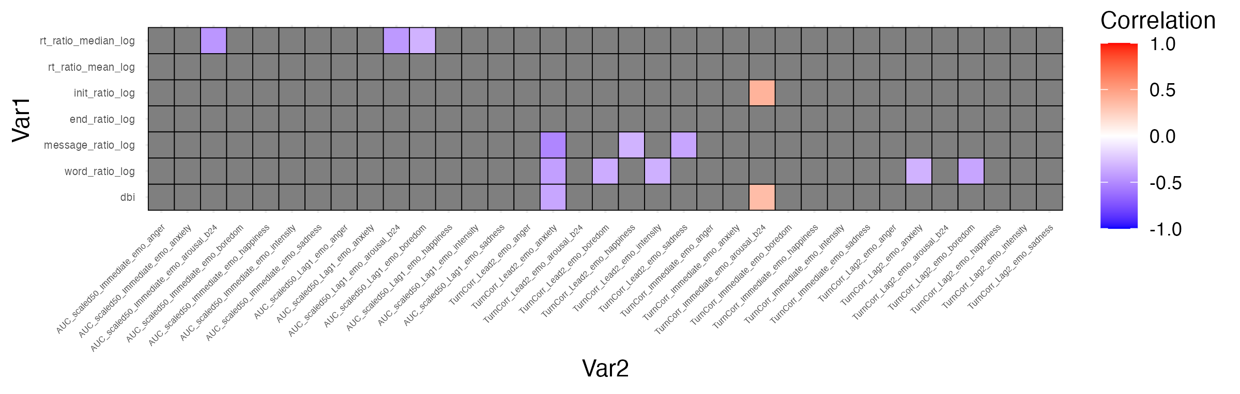
Results:
Notes:
let’s put this in the context of the individual indices to see if these can give us some insight into what variables are actually really driving these relationships.
for the anxiety finding we can see that this relationship is largely driven by number of words sent per message and number of messages sent. so there’s something about the anxiety values in the language that is related to asymmetry in literal volume of texts both in words and messages sent
and for the arousal finding it’s driven mostly by number of conversations initiated. so maybe it’s less about conversational effort at large but rather who is setting the tone at the beginning of each exchange.

Slide 17


Conclusions?:
Partial support for hypotheses—dyadic asymmetry is related to some affective linguistic dimensions but most showed no significant association
High level theme: effort produces reactivity in the moment but does not build lasting emotional momentum in conversation
No alignment (AUC) findings
Future work should examine whether alignment and dyadic asymmetry track each other WITHIN conversations

Slide 18
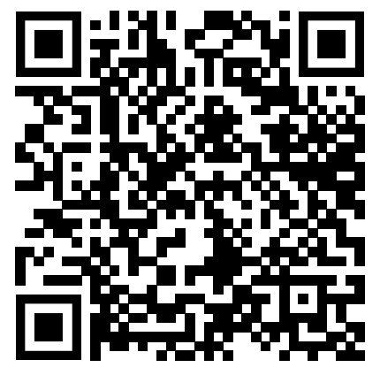
References

Slide 19

Questions?

